Slide 1



EDU-CONSULTANCY SYSTEM
TEAM-04

Slide 2
CONTENT
INTRODUCTION
TECHNOLOGIES USED
IMPLEMENTATION
ADVANTAGES
CONCLUSION
FUTURE SCOPE

Slide 3
INTRODUCTION
The education landscape rapidly evolves, with numerous student options and opportunities.
However, this abundance can often lead to confusion. Traditional methods of consultancy and guidance are time-consuming, lack scalability, and are not always accessible to everyone.
The Edu Consultancy System aspires to create a future where every student has access to personalized guidance and resources, regardless of their location or financial background.
Integrating state-of-the-art technology with education aims to democratize knowledge and opportunity, fostering a world where informed decisions drive academic and professional success.

Slide 4
Its primary focus is to facilitate seamless communication, efficient planning, and effective decision-making in the educational domain.
By integrating modern technologies such as Spring Boot, Angular/React, and AI tools, this platform aims to redefine how educational services are accessed and managed.
This system provides stakeholders with tools to:
Organize training programs for students and professionals.
Offer personalized consultancy services.
Manage educational products and services effectively.

Slide 5
TECHNOLOGIES USED
ANGULAR FOR FORNTEND
SPRING BOOT FOR BACKEND
POSTMAN FOR TESTING THE BACKEND

Slide 6
IMPLEMENTATION
The implementation of the Edu Consultancy System is divided into well-structured modules, each targeting a specific functionality to ensure the platform operates seamlessly.
The system employs a combination of advanced frontend, backend, and database technologies, providing a robust and user-friendly solution.

Slide 7
IMPLEMENTATION PHASES ARE:
Home (Dashboard)
User Authentication and Registration includes admin, student, and parent
forms.
The product
About US
Contact US
Feedback

Slide 8
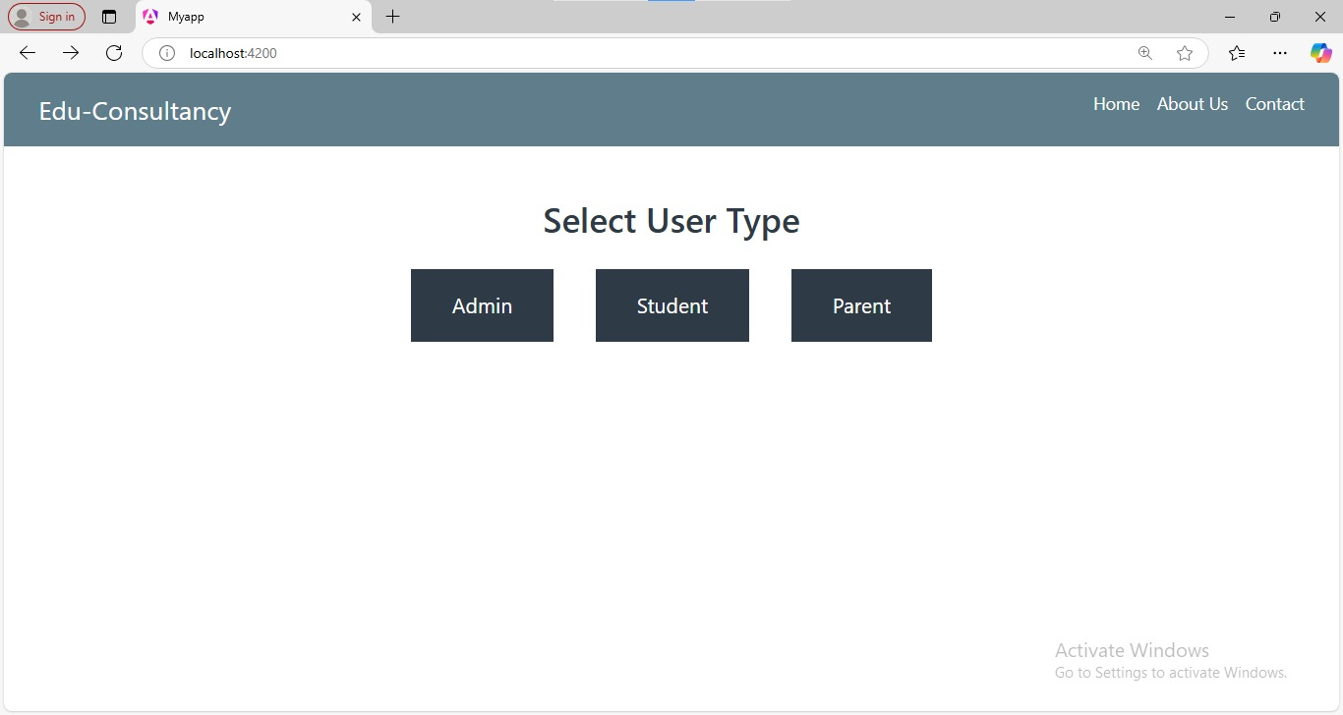

HOME
The Home Page of the system serves as the main interface, where users can select their type (Admin, Student, or Parent) to proceed with the registration process.
It also provides features and services for educational consultancy, catering to the needs of each user type. This page acts as the central hub for navigating the system's functionalities.

Slide 9
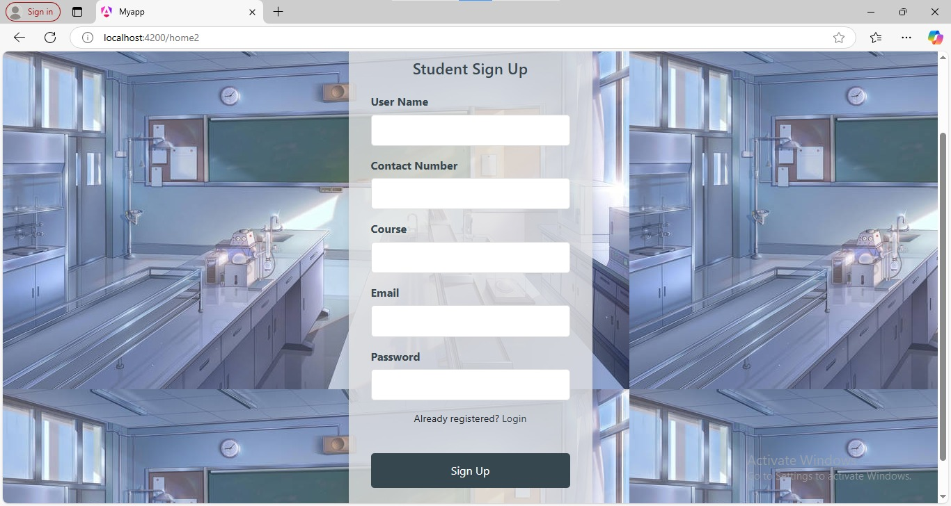
StUDENT SIGN UP
The Signup Page enables students to register for the EDU Consultancy platform, allowing them to establish their role within the system.
This page is designed to meet their specific needs, support their goals, and provide resources for learning and utilizing various technologies
effectively.

Slide 10
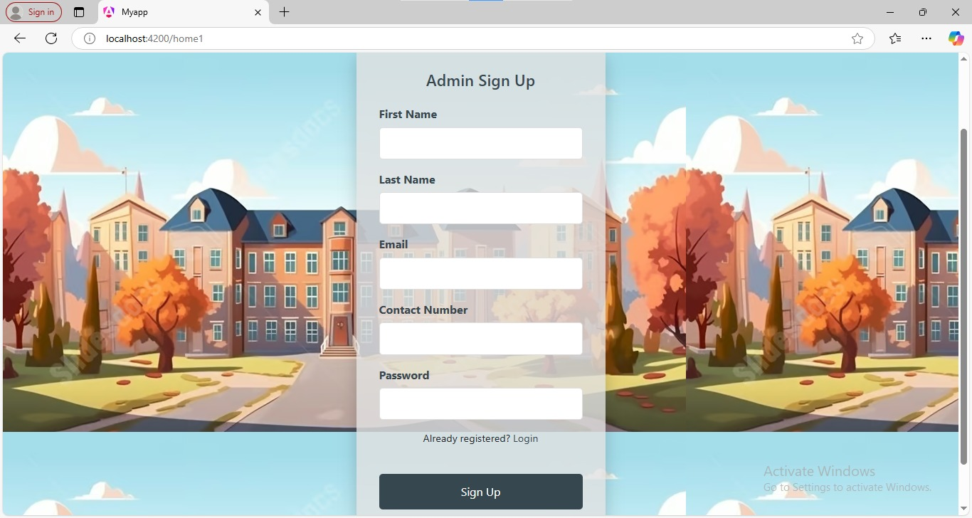
ADMIN SIGN UP
The Admin Signup Page is designed to allow administrators to register and create their accounts within the EDU Consultancy system.
This registration process establishes their role as system managers, enabling them to oversee user activities, manage system settings, and ensure the smooth operation of the platform for all users.

Slide 11
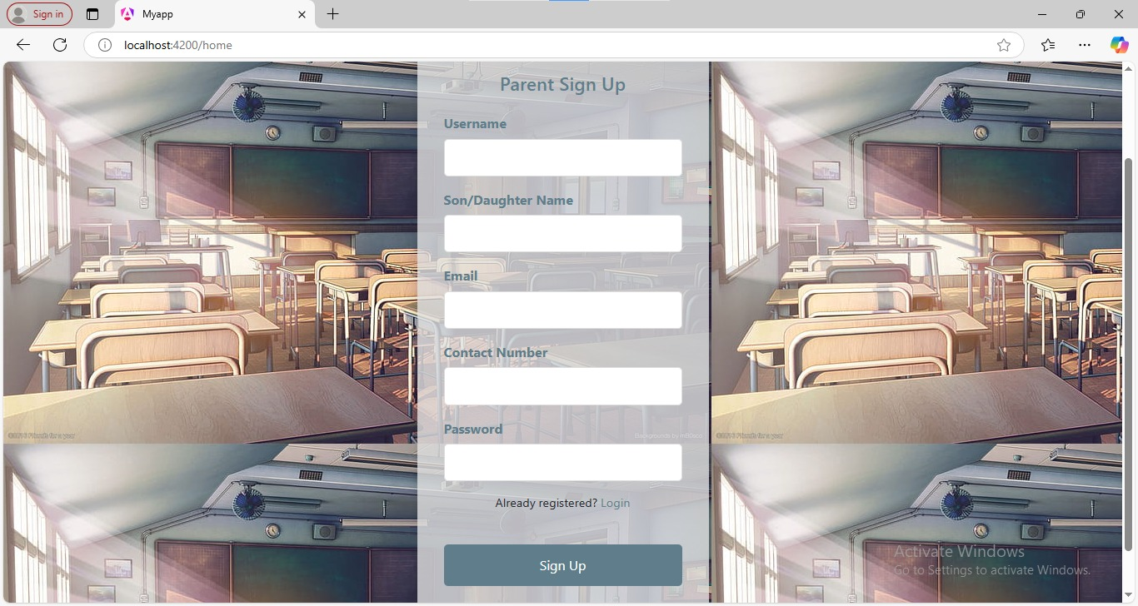
PARENT SIGN UP
The Parent Signup Page allows parents to register and create an account within the EDU Consultancy system.
This registration helps parents engage with the platform to monitor their child's progress, access relevant educational resources, and support their learning journey effectively.

Slide 12
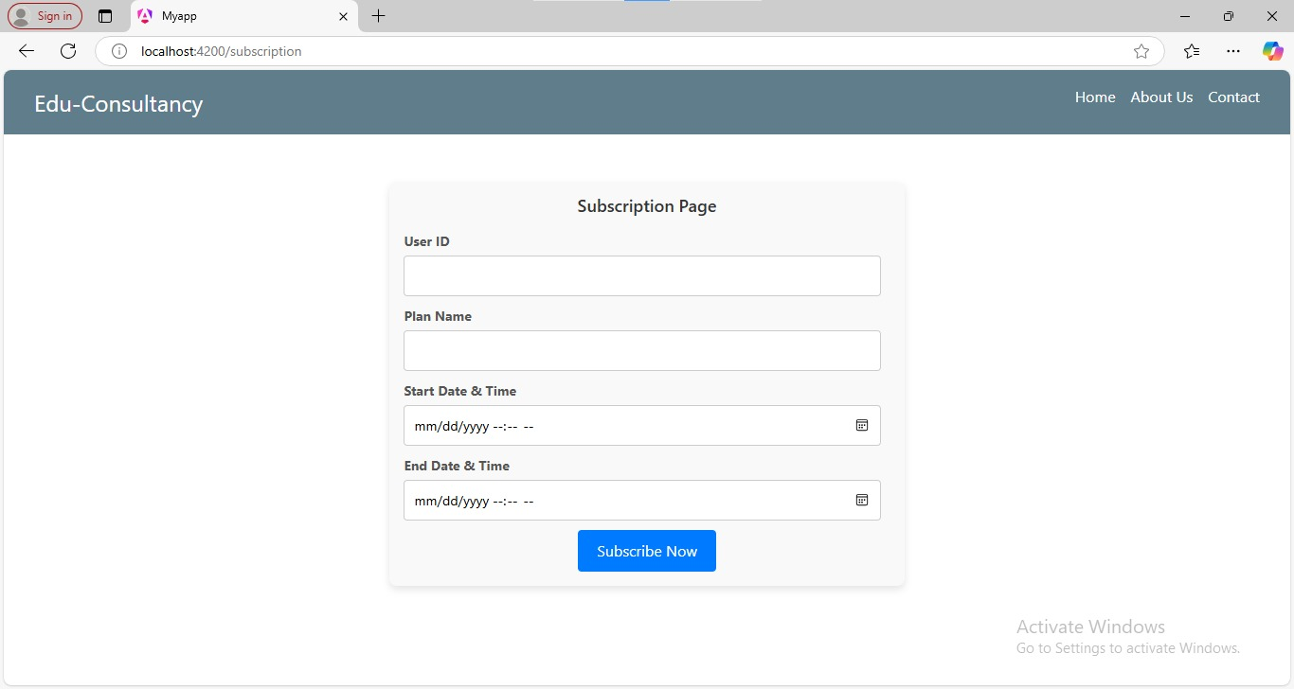
Subscription page
The Subscription Page offers three plans: Basic, Gold, and Diamond, each with a specified start and end date.
Users can choose a subscription based on their needs, with each plan offering different levels of access to educational resources and consultancy services.
The Basic plan provides essential features, while Gold and Diamond plans offer premium benefits, including extended support and advanced learning tools.

Slide 13
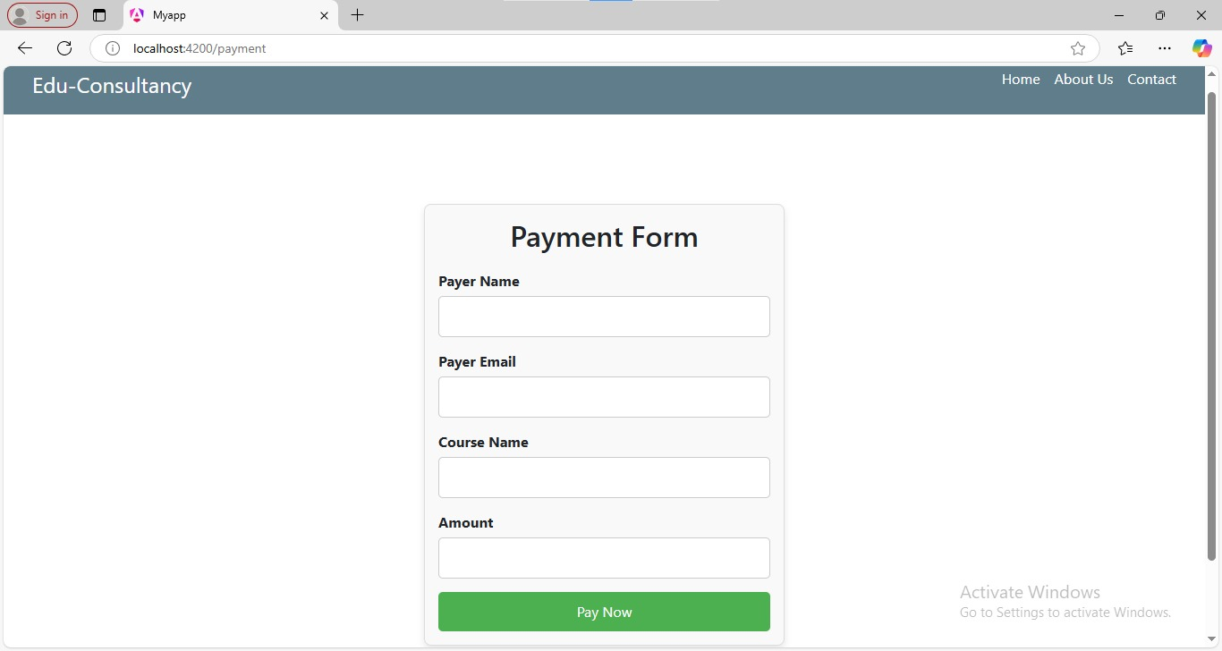
PAYMENT FORM
The Payment Form facilitates secure transactions by capturing essential details such as the selected subscription type and corresponding amount.
Users can review their chosen plan, confirm the payment details, and proceed to complete the transaction seamlessly.

Slide 14
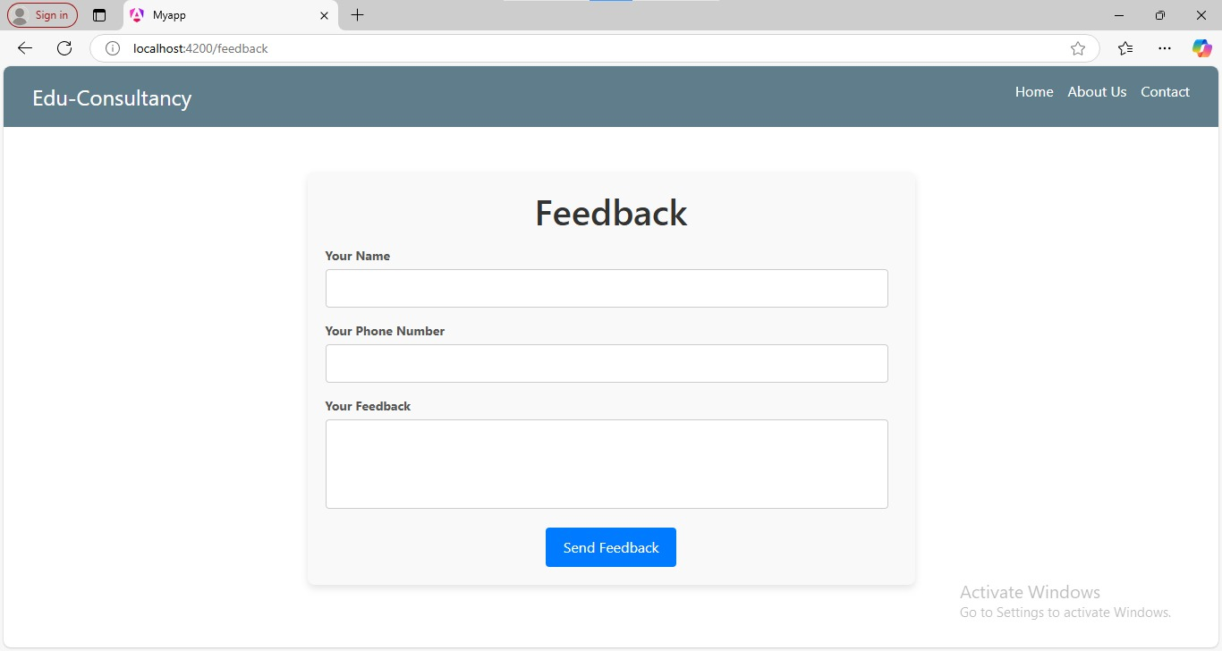
FEEDBACK
The Feedback Page allows registered users to share their genuine reviews and experiences with the system.
This feature helps improve the platform by gathering valuable insights, addressing user concerns, and enhancing overall functionality
to better meet user needs.

Slide 15
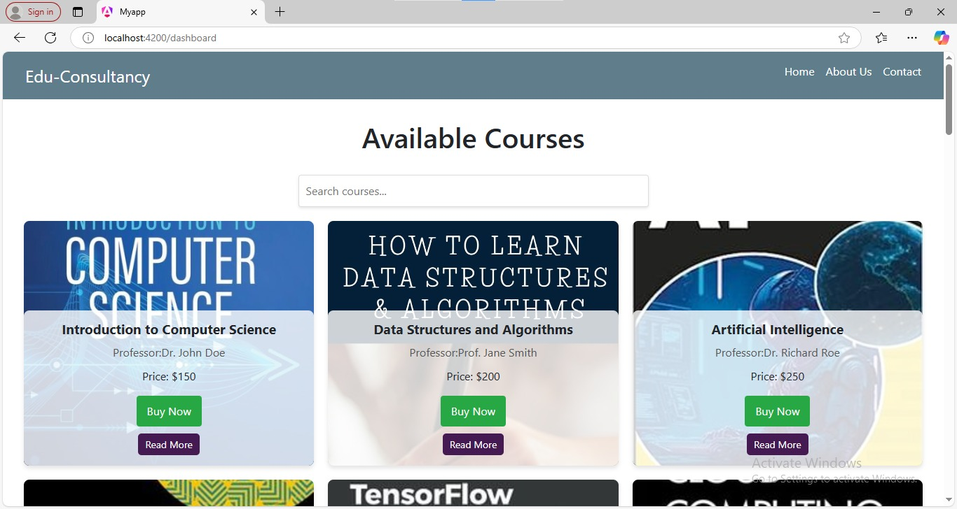
DASHBOARD
The Edu-Consultancy System dashboard displays a list of available courses with titles, professors, and prices. Users can search for courses and access features like "Buy Now" or "Read More" for detailed information.
The interface aims to simplify course selection and improve accessibility for learners.

Slide 16
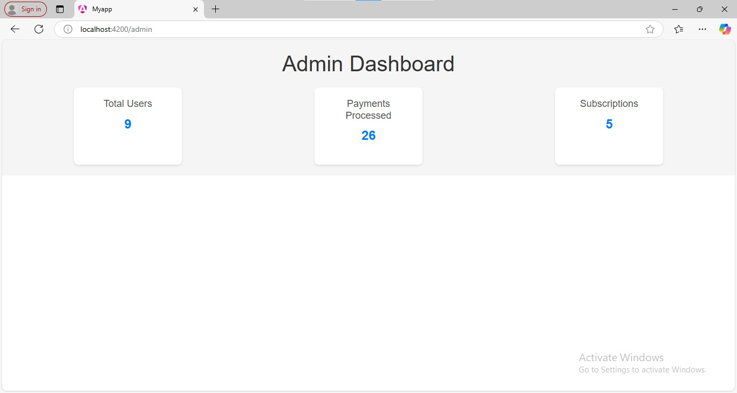
ADMIN DASHBOARD
The Admin Dashboard of the Edu-Consultancy System, providies an overview of key metrics such as Total Users (9), Payments Processed (26), and Subscriptions (5).
It enables administrators to monitor platform activity effectively and manage operations efficiently.

Slide 17
ADVANTAGES
Personalized Guidance
Access to Resources
Enhanced Learning Opportunities
Parental Involvement
Administrative Efficiency
Flexibility and Accessibility
Real-Time Solutions Bridging Gaps

Slide 18
CONCLUSION
EDU-Consultancy is a robust platform designed to connect students, parents, and administrators by offering tailored guidance, skills development resources, and seamless communication. It empowers users to make well-informed decisions regarding education and career planning, ensuring access to comprehensive tools and support systems. With its user-focused approach and real-time functionality, the platform effectively meets the dynamic demands of the modern education landscape, fostering growth and success for all stakeholders.

Slide 19
FUTURE SCOPE
Integration with Emerging Technologies
Global Accessibility
Advanced Features
Mobile App Development
Collaboration with Institutions
Sustainability Focus

Slide 20


